Slide 1
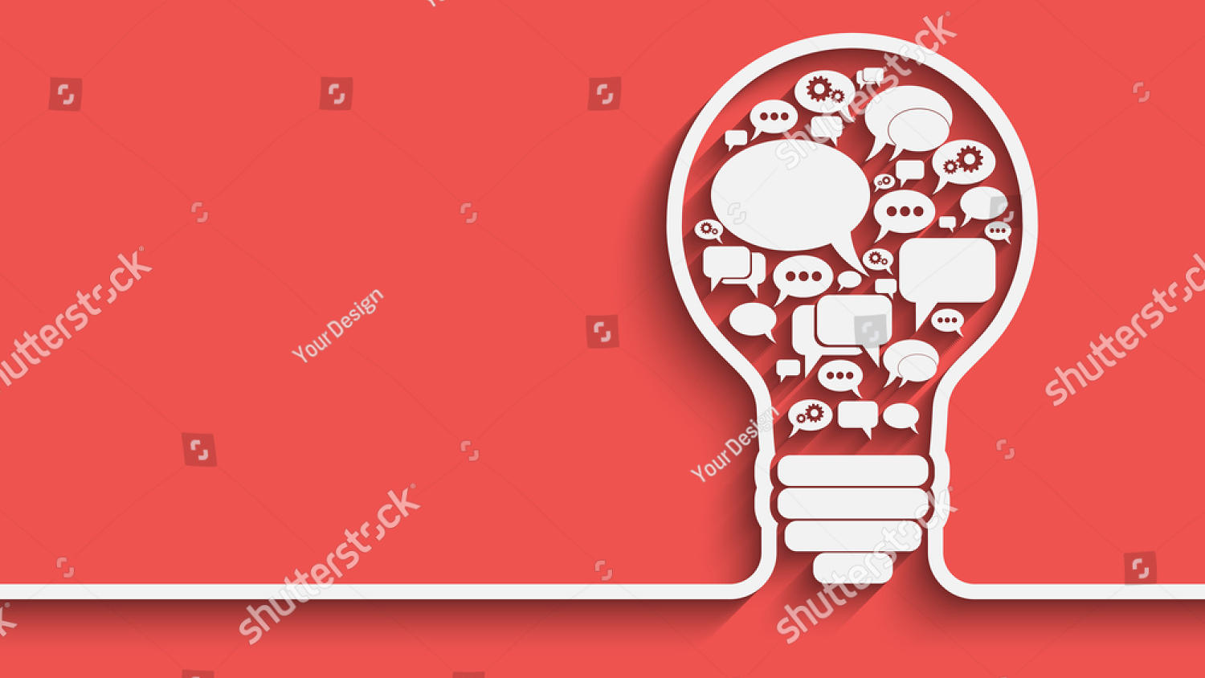
Design Thinking
Notes:
What is Design thinking.
Design Thinking is an approach that prioritizes developing empathy for users, working in collaborative multidisciplinary teams, and using “action-oriented rapid prototyping” of solutions. Design thinking is more than just a process; it opens up an entirely new way to think, and it offers a collection of hands-on methods to help you apply this new mindset.

Slide 2

In essence, design thinking:
Revolves around a deep interest to understand the people
Helps us observe and develop empathy
Enhances our ability to question
Tackle problems that are ill-defined or unknown.
Involves ongoing experimentation through sketches, prototypes, testing and trials of new concepts and ideas.
Notes:
In essence, design thinking:
Revolves around a deep interest to understand the people for whom we design products and services.
Helps us observe and develop empathy with the target users.
Enhances our ability to question the problem, the assumptions and the implications.
Proves extremely useful when you tackle problems that are ill-defined or unknown.
Involves ongoing experimentation through sketches, prototypes, testing and trials of new concepts and ideas.

Slide 3
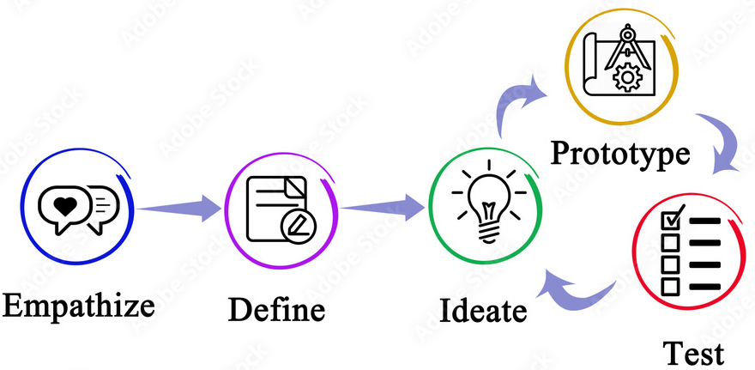
Phases of Design thinking
Notes:
Design thinking is an iterative and non-linear process that contains five phases Empathize, Define, Ideate, Prototype and Test.
The core purpose of the process is to allow you to work in a dynamic way to develop and launch innovative ideas.
As you can see, design thinking offers us a means to think outside the box and also dig that bit deeper into problem-solving. It helps us carry out the right kind of research, create prototypes and test our products and services to uncover new ways to meet our users’ needs.

Slide 4
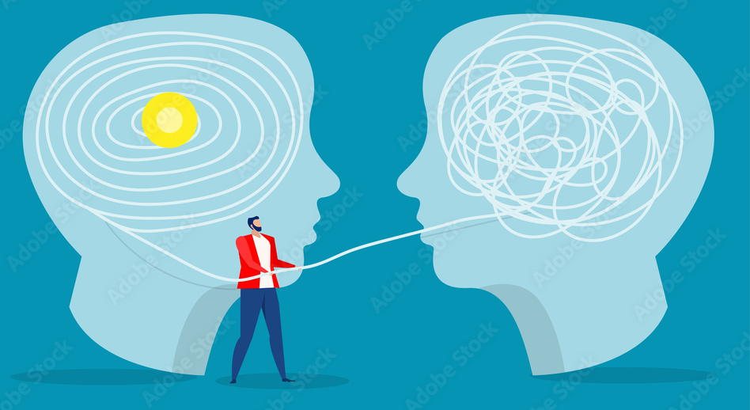
Design thinking in Healthcare
Many healthcare organizations are struggling to retain customers, given archaic service designs and processes.
Design Thinking can encompass the entire spectrum of the healthcare experience
Focus more on understanding the patient experience at a deeper level
Notes:
Design thinking in Healthcare
Many healthcare organizations are struggling to retain customers, given archaic service designs and processes. Consumers have grown accustomed to the personal attention and convenience they find in other industries, such as retail and hospitality, and often lack a similar experience in healthcare.
Design Thinking can encompass the entire spectrum of the healthcare experience — beginning from when a patient gets to the hospital/clinic to what happens when he goes back home and post-visit care.
There is an increased need to focus more on understanding the patient experience at a deeper level to solve whatever problems both sides encounter, along with enhancing the overall experience and lowering its costs.
Lets learn more on Improving Patient Experience Through Design Thinking in Healthcare.

Slide 5
Thank you
Notes:
Thank you.

